Slide 1

PREDICTING THE NBA USING TWITTER: BASED ON SUPPORT VECTOR MACHINE (SVM) SUPERVISED LEARNING ALGORITHM
NAME | HALLTICKET NO
1. K. Ashwini | 196F5A0503
2. B. Lalitha Priya | 186F1A0506
3. G. Deekshith | 196F5A0511
4. S. Karthik Kumar | 186F1A0543
5. K. Karunakar Reddy | 186F1A0529
Project Guide: Mrs. G. Harika (Asst. Prof)

Slide 2
Introduction
What is NBA?
Stands for National Basketball Association
National Basketball Association (NBA) is a professional basketball league in North America.
composes of 30 teams (29 in the United States and 1 in Canada) and is one of the four major professional sports leagues in the United States and Canada.
It is the premier men's professional basketball league in the world which is played in the indoor.
The NBA is now the second most watched sports league in the US, and the tenth most followed sport in the world.
There are total 30 teams in the NBA league and can be divided by 15 teams respectively in Eastern and Western conferences
Objective of this project is to use Twitter API, Machine Learning, Deep Learning and natural language processing skills to predict the game results of NBA (National Basketball Association) based on the tweets on NBA. Thus, more business opportunities maybe detected and utilized not only for NBA but also for other relevant sport leagues.
Commercial and Social Betting on sports like National Basketball Association (NBA) is very common in countries like USA. Therefore, Predicting the outcome of NBA matches as win or lose poses a challenges to the corresponding communities. The League also introduced its new social media like Twitter for informing the goal status of the game, and the tweets made by twitter users.

Slide 3
EXISTING SYSTEM
We will implement the sentiment analysis to the original tweets,sentence_tokenized, and sentence_snowstemmeed to observe the difference between these methods and check their effect. When talking about sentiment analysis, there are three common types we use and rule-based methods will be selected in this chapter because it is easier to apply and there is no need to have an actual training set to train the data.
•Rule-based: Perform sentiment analysis based on a set of predefined rules and sentiment scores.
• Automatic: Using machine learning techniques to learn from data.
• Hybrid: Combine both rule-based and automatic methods.
Twitter as our tool to measure the players' sentiment because a majority of NBA fans tweet their opinions or mind on twitter.

Slide 4
Proposed System
The NBA is now the second most watched sports league in the US, and the tenth most followed sport in the world. The growth in popularity of basketball domestically and internationally makes it an ideal place to apply new Deep learning techniques. The purpose of this project is to apply Machine Learning and Deep Learning methodologies in social media analytics such as Twitter in order to predict the game results of NBA. Thus, more business opportunities may be detected and utilized not only for NBA but also for other relevant sport leagues.
For supervised Learning the data is assumed as large. The nature of the problem is more analysis. The prediction is done based on analysis on hidden patterns extracted from labelled data found. It means the number of dimensions are significantly higher than what we assumed for unsupervised learning, The criteria will have to consider more number of dimensions. The basic data will have more number of columns and record’s. We should reduce the number of fields that have noisy data and it is not important for analysis. So, by removing the fields we’ll make analysis based on SVM(supervised learning algorithm).

Slide 5
SOFTWARE AND HARDWARE REQUIREMENTS:
HARDWARE REQUIREMENTS
Functional Requirements:
Graphical User interface with the User.
Operating Systems supported: Windows 10 64 bit
Technologies used to Develop:Machine Learning, Inferential Statistics, Sentiment Analysis, Deep Learning, Predictive Modelling, Data Visualization
Debugger and Emulator:
▪ Any Browser (Particularly Chrome)
Hardware Requirements:
For developing the application the following are the Hardware Requirements:
▪ Processor: Intel i5
▪ RAM: 4GB
▪ Space on Hard Disk: minimum 525 GB
SOFTWARE REQUIREMENTS:
Language, Libraries and Packages used:
We use Python to develop this project due to the fact that Python is powerful, flexible, and easy-to-use language.
1. Python, JupyterNoteBook
2. Numpy, Pandas, Sklearn, Nltk
3. Matplotlib, Scipy

Slide 6
KEY MODULES
1. Sentiment Analysis: Process of detecting positive or negative sentiment in text. Classified into the following grades: Very positive, Positive, Neutral, Negative, Very negative.
2. Supervised Learning :An approach to creating artificial intelligence (AI), where a computer algorithm is trained on input data that has been labelled for a particular output.
3. SVM ( Support Vector Machine): Machine learning algorithm that can be used for both classification and regression challenges. Mostly used in classification problems.
4. Machine Learning: Study of computer algorithms that can improve automatically through experience and by the use of data. Build a model based on sample data, known as training data, in order to make predictions or decisions without being explicitly programmed to do so.
5. Prediction: A prediction is a reasonable guess as to what will happen. A prediction is a forecast, but not only about the weather.
6. Artificial Intelligence: The ability of a computer or a robot controlled by a computer to do tasks that are usually done by humans because they require human intelligence and discernment.
7. Natural Language Processing : Natural Language Understanding helps machines “read” text (or another input such as speech) by simulating the human ability to understand a natural language such as English, Spanish or Chinese. Natural Language Processing includes both Natural Language Understanding and Natural Language Generation, which simulates the human ability to create natural language text e.g. to summarize information or take part in a dialogue.
8. Data Pre-processing : A Data Mining technique which is used to transform raw data into a useful and efficient input.

Slide 7
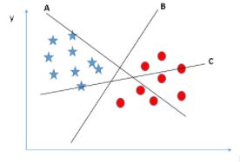
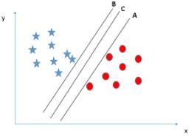
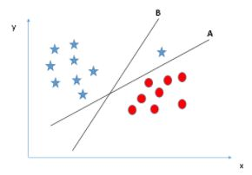
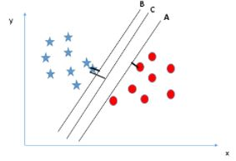
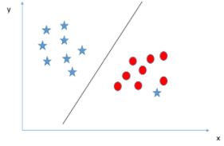
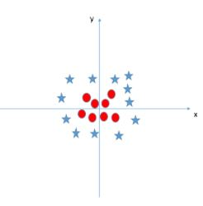
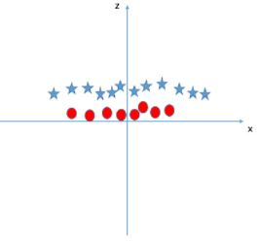
IMPLEMENTATION:
Support Vector Machine(SVM)
1. Most popular Supervised Learning algorithms, which is used primarily, for Classification problems in Machine Learning.
2.The goal of the SVM algorithm is to create the best line or decision boundary that can segregate n-dimensional space into classes so that we can easily put the new data point in the correct category in the future.
3.SVM chooses the extreme points/vectors that help in creating the hyper plane.
4. These extreme cases are called as support vectors, and hence algorithm is termed as Support Vector Machine.
5.Types of SVM:
Linear SVM
Non- Linear SVM

Slide 8
Conclusion
After comparing with four different algorithms, we conclude that supervised learning algorithms (Naive Bayes and SVM) have better performances than unsupervised learning algorithms (K-means and LDA).[5] The possible reason is because labels utilized in supervised learning algorithms may strengthen the features of tweets; therefore, it can improve the accuracy of predictions in NBA game results.

Slide 9


